Slide 1
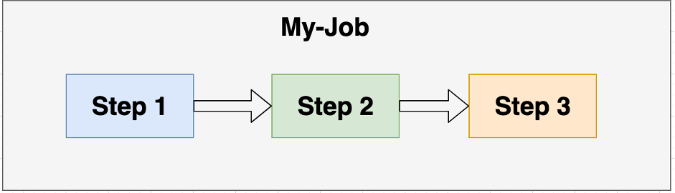
Spring Batch-multi Steps

Slide 2
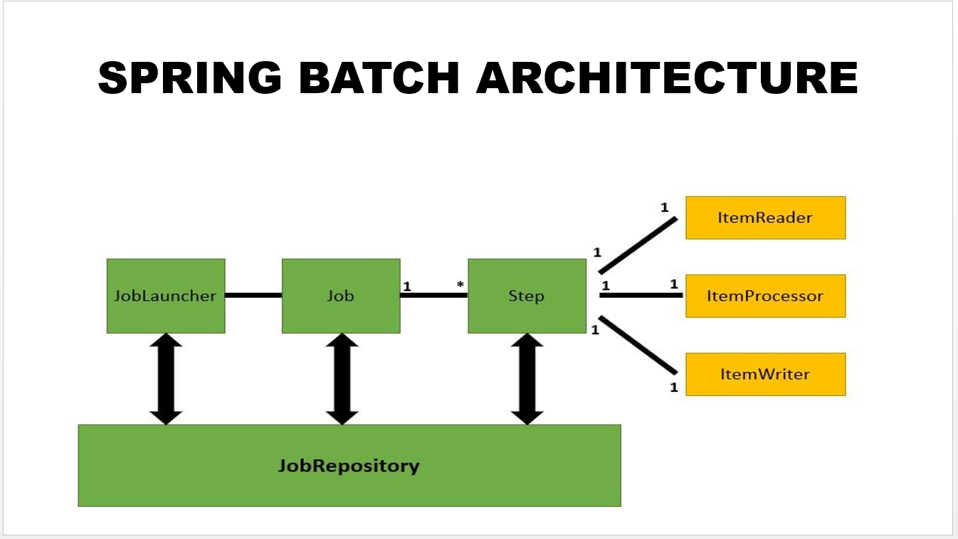
what is spring batch job?
A job can have more than one step. And every step typically follows the sequence of reading data, processing it and writing it.
Job can contain multi steps and has job launcher

Slide 3
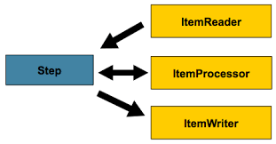
what is spring batch step?

Slide 4
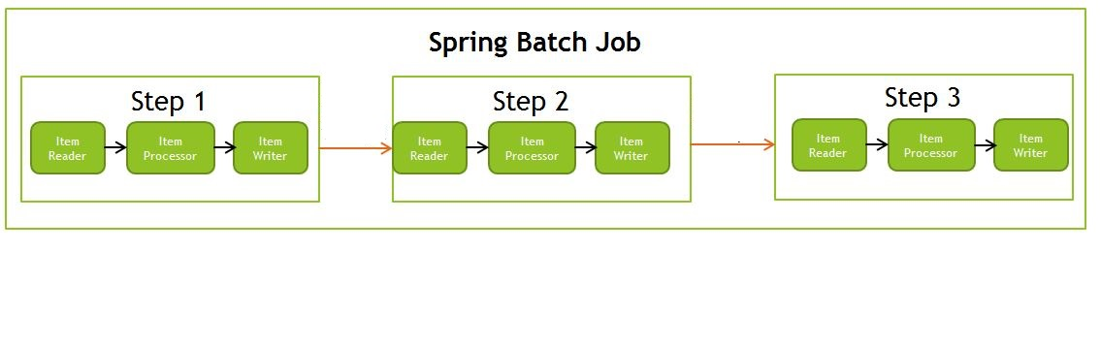
Spring batch multi step

Slide 5
References
Spring Batch Parallel Processing Example - Examples Java Code Geeks - 2023
java - How to combine multiple listeners (step, read, process, write and skip) in spring batch - Stack Overflow

